Slide 1
IOT Based Smart garbage and Drainage monitoring System
Guide Done by
G. Navya G. Vivek Sai 19P81A0407
M.G. Navaneeth 20P85A0403

Slide 2
Introduction
Typically, the population in the city locations is growing day by day. These bring about the extra requirements of the resident in the metropolitan location.
As the populace is enhancing the quantity of the waste generated is likewise high. The environments obtain filthy delicately.
This causes extreme strike on atmosphere if it is not recycled and there by impacts person's wellness.
As much as 40 per cent of plastic waste collected in India remains uncollected and littered on the streets, Union Minister of Environment, Forest and Climate Change Prakash Javadekar told the Lok Sabha on November 22, 2019.

Slide 3
Existing System
Earlier systems which was design was not cost efficient also they are bulky in size, as they were using Raspberry-Pi module, GSM module, also some using GPS antenna, etc.
Due to this, the garbage shrinks and produces the bad smell which will tends to cause the air pollution and spread diseases. That can cause the harm to human health. Thus, cleaning is the big issue. Also finding the path of garbage bin is one of the tasks specially for new driver
Disadvantages of existing system
➢ Cleaning of bins is not done properly
➢ It causes the Unhygienic condition and spoil the environment.
➢ Bad smell spreads and may cause illness to human beings

Slide 4
Proposed System
Here in our proposed system we have removed all the hardware part to reduce the size of circuitry this will also reduce the cost of the system.
We designed a simple light weight and latest board which reduced the size of the circuit. Our System contains two kind of sub system ,one will monitor the garbage level and other will monitoring the water level in the drainage pipeline.
The alerting system will give the latest updates of levels of the garbage and water level in drainage in the website

Slide 5
Block Diagram
Power Supply Adaptor
Node MCU
Ultrasonic q sensor
I2C LCD
Water Level sensor
GPS

Slide 6
Components
Regulated power supply: A regulated power supply converts unregulated AC (Alternating Current) to a constant DC (Direct Current). A regulated power supply is used to ensure that the output remains constant even if the input changes.
GPS: The Global Positioning System (GPS) is a U.S.-owned utility that provides users with positioning, navigation, and timing (PNT) services.
I2c LCD:The I2C bus is a standard bidirectional interface that uses a controller, known as the master, to communicate with slave devices. A slave may not transmit data unless it has been addressed by the master.

Slide 7
Water level sensor
A water sensor is a device used in the detection of the water level for various applications. Water sensors can come in several variations that include ultrasonic sensors, pressure transducers, bubblers, and float sensors.
Operating voltage: DC 3v to 5V
• Operating current: less than 20mA
• Sensor Type: Analog
• Detection Area: 40mm x 16mm
• Production process: FR4 double-sided HASL

Slide 8
VCC: Connected to the power supply positive 3v to 5V
• GND: Connected to the power supply negative
• AO: Analog 0-2.3V DC
• Size: 32mm x 14mm (1.26inch x 0.55inch)

Slide 9
Ultrasonic sensor
Ultrasonic sensors are generally used to measure distance by using ultrasonic waves.
The sensor head emits an ultrasonic wave and receives the wave reflected back from the target.
Ultrasonic sensors measure the distance to the target by measuring the time between the emission and reception.
The sensing range lies between 40 cm to 300 cm.
It operates within the voltage range of 3.3 VDC to 5 VDC
The frequency of the ultrasound wave is 120 kHz

Slide 10
NodeMCU
Esp8266 D1 Mini NodeMCU Wifi Development Board is an Arduino Compatible mini wifi board with 4MB flash based on ESP8266EX.
The board is with 11 digital input/output pins, all pins have interrupt/PWM/I2C/one-wire supported(except D0) 1 analog input(3.3V max input) and a Micro USB connection.
Working: NodeMCU is main component which process data based on alogorithim by taking input from the input devices.The processed output is then send to the

Slide 11
Features of NodeMCU
11 digital input/output pins, all pins have interrupt/pwm/I2C/one-wire supported(except for D0)1 analog input(3.2V max input)Micro USB connection Compatible with Arduino Compatible with nodeMCU.
Operating Voltage 3.3 V
Digital I/O Pins 11Analog Input Pins 1(Max 3.2V)
Clock Speed 80MHz .Flash 4M bytes
Compatible with both Arduino and nodeMCU

Slide 12
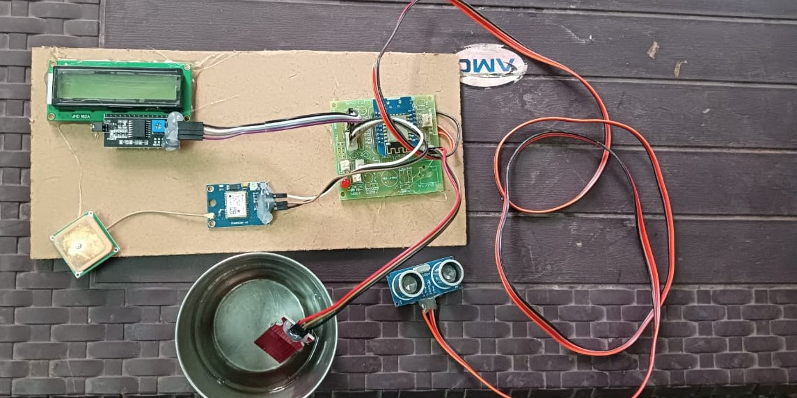
Circuit diagram

Slide 13
Working
IOT based smart garbage monitoring and drainage system using ESP8266 is very simple and real time. Basically, the process starts from the garbage bin.
Ultrasonic sensors are fixed on each level of the garbage bin. Here we are taking the 3 levels of the garbage bin for our project demonstration.
We are providing the unique ID for each garbage bin. Also, we are selecting the threshold level for alerting purpose.
As soon as the garbage in the garbage bin or water level in drainage crosses the threshold level, the alerting text message will get provided to the concerned person or in the municipality office. This message contains the garbage bin ID along with the GPS link.

Slide 14
Advantages & Disadvantages
Advantages
It keep our Environment clean & Green.
The cost & effort are less in this system.
To collect dustbins at public places in city.
Disadvantages
Many times garbage dust bin is over flown and many animals like dogs or goat enters inside or near the dust bin. This creates a bad scene. Also some birds are also trying to take out garbage from dustbin. This project can avoid such situations
This is applicable for only large farms.
Have limited life after installation.

Slide 15
Applications
This project can be used in the “SMART CITY”.
This project is helpful for the nation’s “CLEAN INDIA MISION”.
This project is also helpful in the Government project of “SWACH BHARAT ABHIYAN”.
This project can also be used in college/university cumpus.
This project when implemented reduces the human interference and also increases the efficiency of waste collection.

Slide 16
Conclusion and Future scope
In this entire world, waste management is a major challenging issue that plays a very important role in the development of the nation. If it is not properly disposed or cleaned which will causes lot of diseases and spoil the green environment? Using IoT there are different and efficient solutions for waste management with minimum human attention. In this paper we have addressed and came across the various techniques of waste management. We have considered solutions for checking status of trashcans, sending information to respective person by giving shortest way to collect it.
Now this system can be used in certain areas but as soon as it proves its credibility it can be used in all the big areas. In future, a team can be made which will be in charge for handling and maintaining this system and also to take care of its maintenances. Inclusion of the control room will effectively help monitor the garbage level from the Central Office. Integrating the system with an application based website to have an exact location on the map.

Slide 17


THANK YOU

